Slide 1
Scalable Multi-match Packet Classification Using TCAM and SRAM
Author: Yu-Chieh Cheng, Pi-Chung Wang
Publisher: IEEE Transactions on Computers (2015)
Presenter: Yen-Chun Tseng
Date: 2015/9/9
Department of Computer Science and Information Engineering
National Cheng Kung University, Taiwan R.O.C.
Notes:
1

Slide 2
Outline
Introduction
Proposed scheme
Performance Evaluation

Slide 3
Introduction
The approach offload the overhead of TCAM to SRAM to achieve efficient multi-match packet classification.
The scheme synthesizes TCAM compatible entries by using binary decision trees and employs SRAM for further comparisons.
Notes:
When packet matches expression, may do less work than Thompson's
algorithm

Slide 4
Outline
Introduction
Proposed scheme
Performance Evaluation

Slide 5
Proposed scheme
A root node corresponding to the whole k-dimensional space, and all rules are stored in the list.
The rule list of a leaf node is allowed to have at most bin-threshold (binth) rules.
If the length of a rule list is more than binth, then two child nodes will be appended to the node by halving the length of a selected dimension.
Notes:
Replication越多 樹高越高 leaf 越多 不好

Slide 6
Proposed scheme
An index rule is synthesized for each leaf node. Each index rule consists of two parts, rule specification stored in TCAM and the associated original rules stored in SRAM.

Slide 7
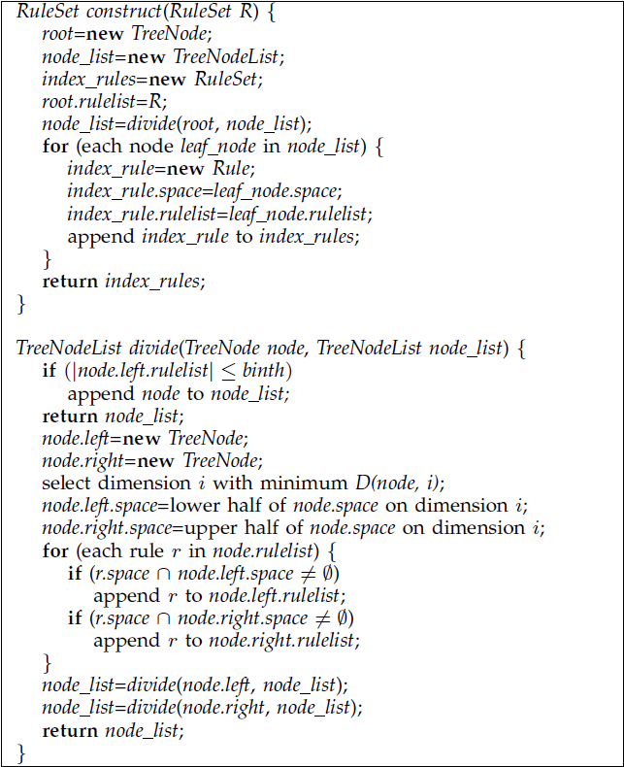
Proposed scheme

Slide 8
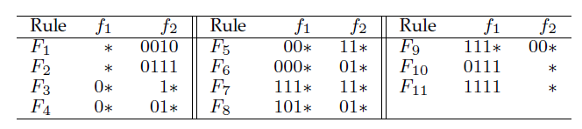
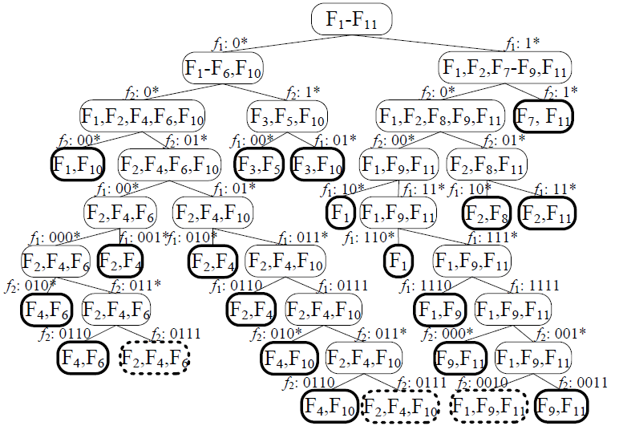
Proposed scheme
binth = 2
Notes:
F1有八個相異的 prefix f2只有七個

Slide 9
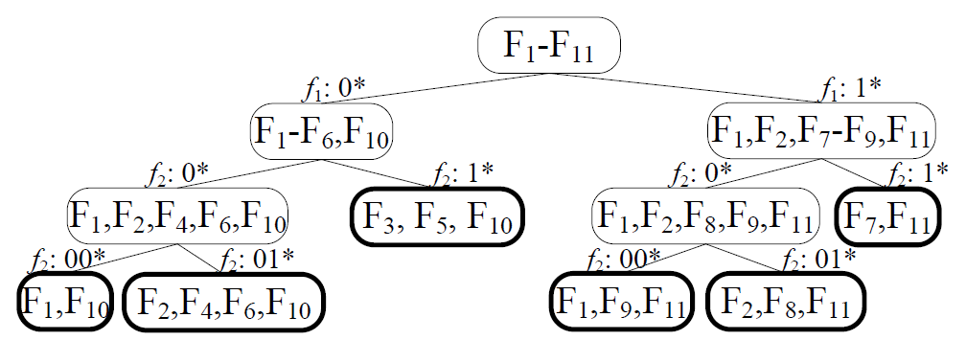
Proposed scheme
binth = 4
Notes:
leaf nodes is greatly reduced 但在linear search 上又會變慢

Slide 10
Proposed scheme
For each rule, there is a counter which is initially set to zero.
When a node is split into two child nodes, each rule of the parent node is tested to identify the presence of overlapping child nodes. If a rule overlaps more than one child node, then the counter value is increased by one.
Notes:
為了讓 leaf node更少 大於expansion factor的rule會拿掉

Slide 11
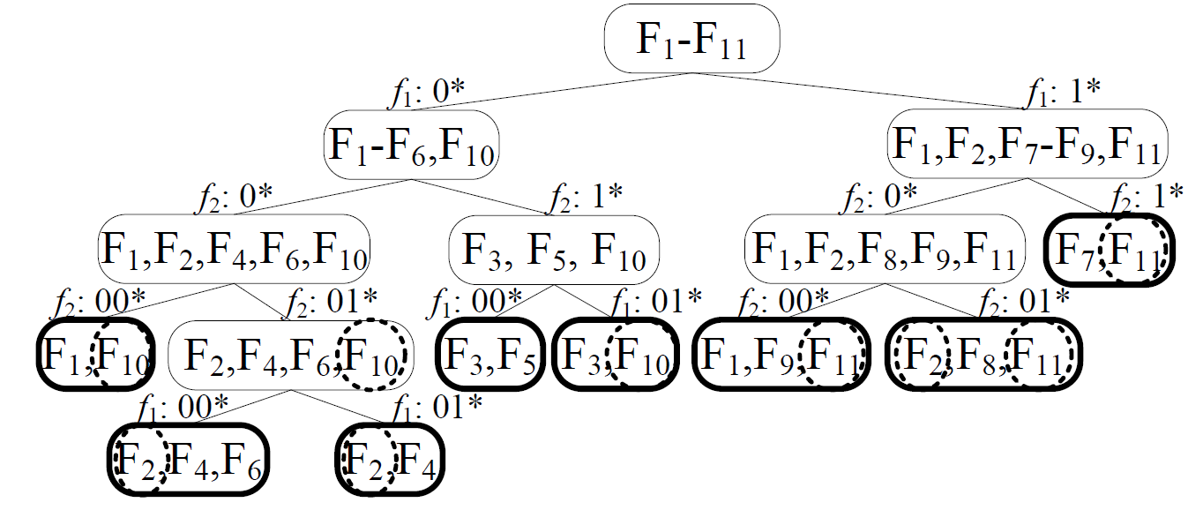
Proposed scheme
binth = 4
expansion factor = 2

Slide 12
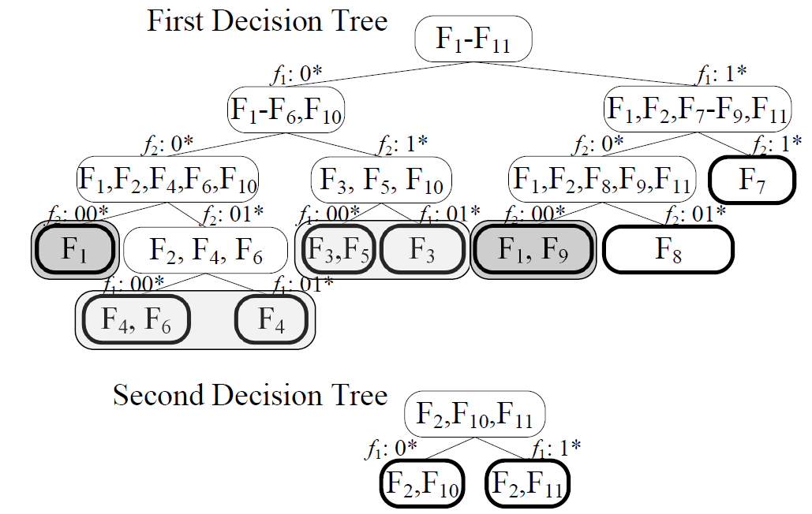
Proposed scheme
(0*, 00*) F1
(1*, 00*)F1, F9
can also be merged into
(*, 00*)F1, F9

Slide 13
Proposed scheme
Merge
  First, the field specifications of the index rules of both leaf nodes can be merged into one ternary string.
  Second, the total number of distinct rules in both nodes is less than the binth value.

Slide 14
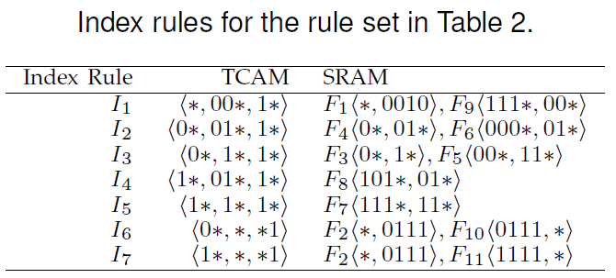
Proposed scheme

Slide 15
Proposed scheme
To yield all matching index rules, one d-bit bitmap is appended to the search key in each TCAM access.
Initially, all bits of the bitmap are set to one to compare all index rules. Assume that an index rule from the jth decision tree matches the search key. In the next iteration, the jth bit of the bitmap is set to zero so that the same index rule will not match the search key again

Slide 16
Proposed scheme
packet (0111,0111) → (0111,0111,11)

Slide 17
Proposed scheme
packet (0111,0111) → (0111,0111,11)
I2 → (0111,0111, 01)

Slide 18
Proposed scheme
packet (0111,0111) → (0111,0111,11)
I6 → (0111,0111, 00)

Slide 19
Proposed scheme
packet (0111,0111) → (0111,0111,11)
I2(F4,F6) I6(F2,F10) → F2 F4 F10

Slide 20
Proposed scheme
Rule deletion by removing the deleted rules from the corresponding SRAM entries without modifying TCAM entries.
After removing a rule, the update procedure should check whether the original index rule can be merged with another one.

Slide 21
Proposed scheme
The first step starts by randomly generating an address which matches the inserted rule to access TCAM.
By comparing the inserted rule and the matching index rules, we can determine whether the new rule is enclosed by an index.

Slide 22
Outline
Introduction
Proposed scheme
Performance Evaluation

Slide 23
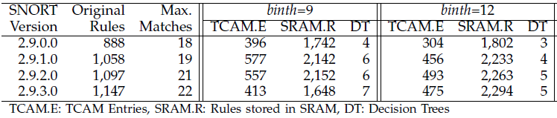
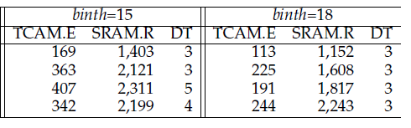
Performance Evaluation

Slide 24
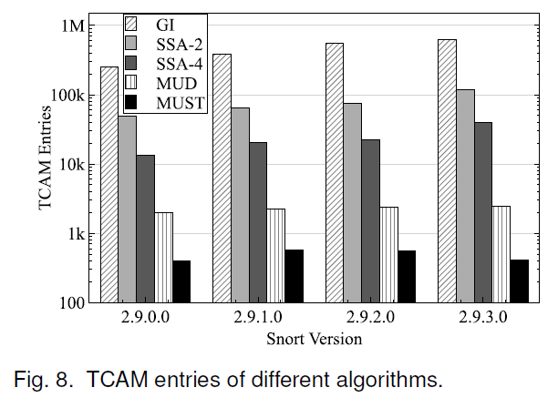
Performance Evaluation

Slide 25
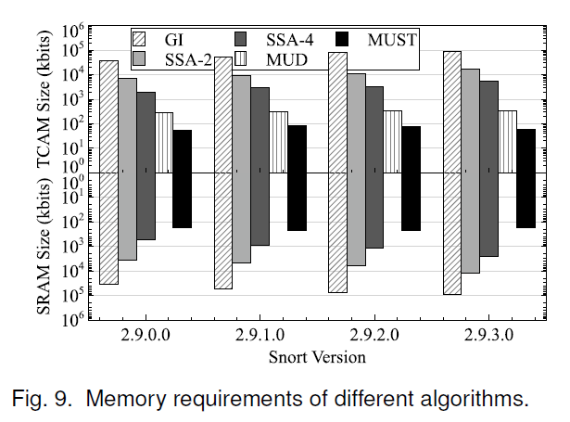
Performance Evaluation

Slide 26
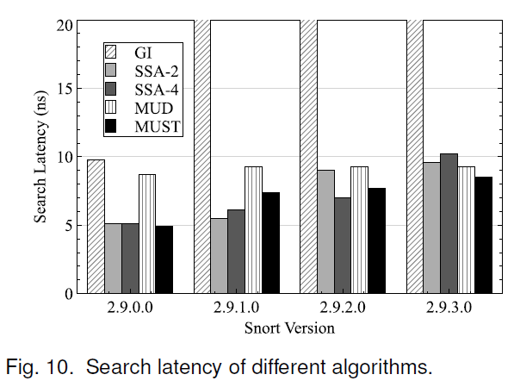
Performance Evaluation

Slide 27
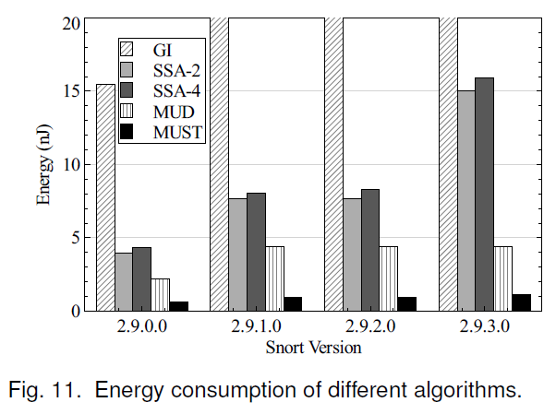
Performance Evaluation

Slide 28
